Slide 1
Rob’s Rules … Updated
Bay County SHRM Annual Meeting 2025
Robert C. Jackson, Esq.
Hand Arendall Harrison Sale
Destin, Panama City, Panama City Beach, Santa Rosa Beach, Destin
and throughout Alabama

Slide 2
Who is Rob? Why should you care?
Bay County SHRM Annual Meeting 2025

Slide 3
What the heck are Rob’s Rules?
Bay County SHRM Annual Meeting 2025

Slide 4
Basic Employment Rules Time-tested Framework to keep you grounded Major cultural and legal shifts happening now Remember the Pirate Code - “more like guidelines” Business Size and Culture Matter
Rob’s Rules for Employers 2025

Slide 5
The Lindy Effect The Lindy Effect states that the longer something non-perishable (like a book, idea, or technology) has existed, the longer it is likely to continue existing
Rob’s Rules for Employers 2025

Slide 6
Rob’s Rules for Employers 2025
Rule No. 1
HIRE WELL
Easiest Way to Mitigate Risk:
Hire Good People
Treat Them Well

Slide 7
Rob’s Rules for Employers 2025
Rule No. 2
PAY EMPLOYEES PROPERLY

Slide 8
Misclassifications
Rob’s Rules for Employers 2025
FLSA – Was a hot Area – Now ?
Liquidated Damages?
Exempt vs Non-Exempt and IC v EE
Overtime – Tipping issues here to stay
IRS and DOL

Slide 9
Rob’s Rules for Employers 2025
Rule No. 3
EVALUATE QUICKLY
Generally, within 90 days

Slide 10
Rob’s Rules for Employers 2025
Rule No. 4
DOCUMENT! DOCUMENT! DOCUMENT!
“the dullest pencil is better than the sharpest memory"

Slide 11
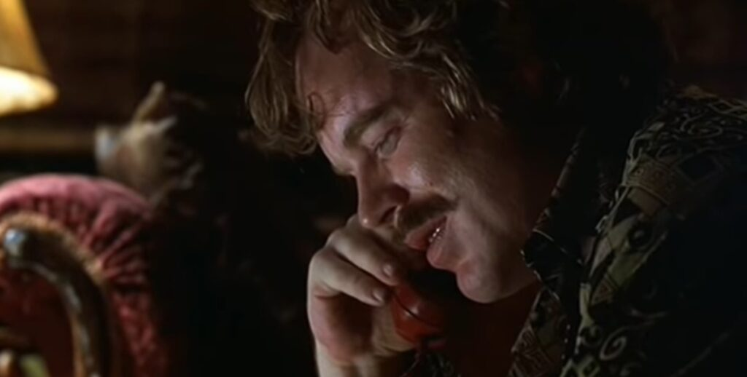
Lester Bangs Rules for Evaluations
“My advice to you. I know you think those guys are your friends. You wanna be a true friend to them? Be honest, and unmerciful."

Slide 12
Conversations
Rob’s Rules for Employers 2025
Keep it Job Related
Personal, But Not Too Personal
Good Eye Contact – no email
Firm, But Kind

Slide 13
Rob’s Rules for Employers 2025
Rule No. 5
RESOND TO
PROBLEMS PROMPTLY
Be a Ferret, Not an Ostrich

Slide 14
Complaints
Rob’s Rules for Employers 2025
Take Them Seriously
Investigate as Needed
Can be Formal or Informal
Act Professional
Do Not Retaliate!!!
Document! …. But can be tailored

Slide 15
Rob’s Rules for Employers 2025
Rule No. 6
HAVE GOOD POLICIES
Sexual Harassment, PTO, Compensation, Medical, Privacy, Computer Use, Social Media(?)

Slide 16
Email / Social Media
Rob’s Rules for Employers 2025
Crosses Private – Public barrier
Keep it Job Related
Generally, apolitical…. But No Free Speech
“Don’t be Stupid!”
Internet is Forever

Slide 17
Rob’s Rules for Employers 2025
Rule No. 7
FOLLOW YOUR POLICIES
Duhhhhhhhh……
But harder than you think

Slide 18
Rob’s Rules for Employers 2025
Rule No. 8
ALWAYS ACT PROFESSIONAL
You will never regret taking the High Road

Slide 19
Rob’s Rules for Employers 2025
Rule No. 9
PREPARE, DON’T PREDICT
OLD RULE: Trust, But Verify
EPLI, Regulations, Medical, ADA, etc…

Slide 20
Rob’s Rules for Employers 2025
Rule No. 10
CONVINCE EMPLOYEES TO FIRE THEMSELVES
Hold Them Accountable
Manage Expectations
Honest, Unmerciful, but with Respect

Slide 21
Florida’s Non-Compete Overhaul
Florida Choice Act
New Legislation: “Contracts Honoring Opportunity, Investment, Confidentiality, and Economic Growth"
Passed both Chambers – awaiting Governor’s signature
If signed, effective July 1, 2025
Rob’s Rules (current) on Non-Competes
CHOICE expands Florida’s ER friendly approach

Slide 22
New CHOICE Provisions
Florida Choice Act
Only applies to “Covered EE ad ERs
EEs and IC who earned more 2x county avg wage
Bay County: $56,463 – so $112K
Garden Leave Agmt: up to 4 years of pay
Non-Compete Agmt: up to 4 years of restrictions
Mandatory Injunctive Relief
Some exemptions: (health care)
Why? FTC decision

Slide 23
Generational Change
Rob’s Rules for Employers 2025
DEI / Affirmative action
Employee vs Employer
Manufacturing vs College
Regulation Push Back
Social Interaction and Culture
Financial Changes

Slide 24
Rob’s Rules for Employers 2025
Rule No. 9
PREPARE, DON’T PREDICT

Slide 25
Questions? Thank you
Rob’s Rules for Employers 2025
Robert C. Jackson, Esq
Hand Arendall Harrison Sale
Destin, Panama City, Panama City Beach, Santa Rosa Beach, Destin
and throughout Alabama

